Slide 1
Class 6 History Notes

Slide 2
Chapter 1
Sulaiman and Karthar hills: wheat and barley– 8000 years ago.
Rice first grown north of Vindhyas.
Ashokan inscription at Kandahar: 2250 years ago – written in Greek and Aramic.

Slide 3
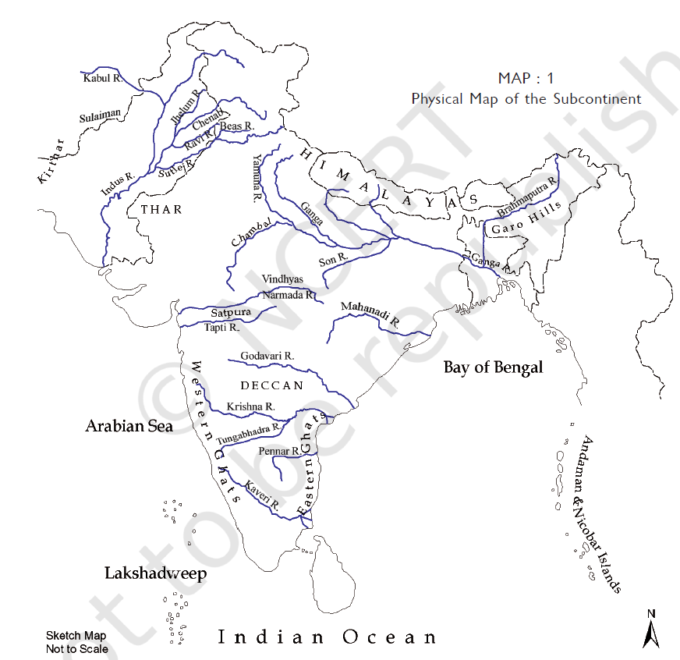

Slide 4
Chapter 2
Why people moved: Consumed all resources at a location – prey move from place to place hence follow it – plants and trees are seasonal – water availability during seasons.
Bhimbetka cave paintings.
Traces of ash found in Kurnool caves – fire was known to them.
Age | Year | Note
Palaeolithic (lower, middle and upper) | 2 million – 12,000 years ago | Stone tools
Mesolithic | 12,000 – 10,000 years ago | Microlith stone tools (attached to handles)
Neolithic | 10,000 – present

Slide 5
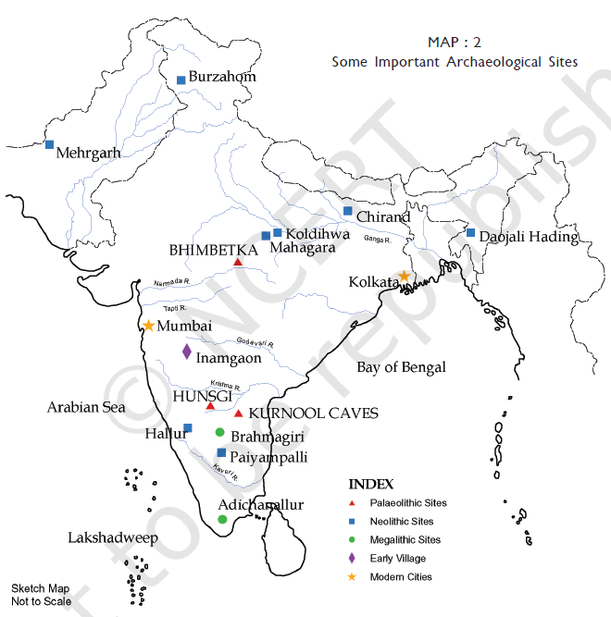
Palaeolithic sites:
Kurnool
Hungsi
Bhimbetka
Megalithic sites:
Adichamallur
Brahmagiri
Bhimbetka
Neolithic sites:
Mehrgarh
Burzahom
Koldihwa
Mahagara
Chirand
Daojali Hading
Hallu
Paiyampalli
Early Villages: Inamgaon

Slide 6
Burzahom

